Slide 1
Segmentation of Places
A cluster based machine learning approach to segment places and provide some valuable insights to the stakeholders
Saurabh Naik
01-11-2022

Slide 2
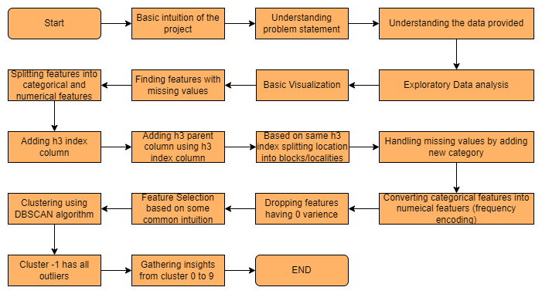
Flowchart

Slide 3
Problem Statement
You will be given POI (Point of Interest) data from OSM (openstreetmaps).
These POIs will include locations ranging from grocery stores, shopping malls to car dealerships within the city.
You may also enrich your POI (point of interest, meaning, what type of place- showroom/ building/ outlet/ shop etc.) data using any location data available on the web (that you can extract/scrape).
Your goal is to divide the city geographically into various blocks/localities. Next you are supposed to create clusters of similar localities and characterize each cluster so that these clusters are human interpretable.

Slide 4
Data Description
The schema of OSM data is given below:
1. source: source from where the data was collected
2. poi_code: unique identifier of the POI
3. name: name of the POI
4. poi_type: type of POI (e.g car dealership, shopping mall, etc)
5. lat: latitude of the POI
6. long: longitude of the POI
7. address: address of POI
8. city: city of POI
9. state: state of POI
10. country: country of POI
11. pin_code: pincode of POI
12. brand: brand information of POI

Slide 5
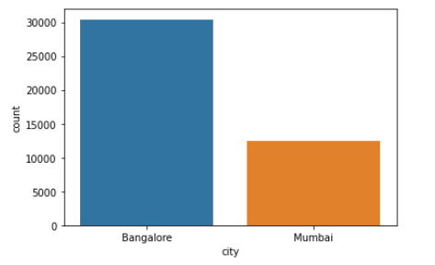
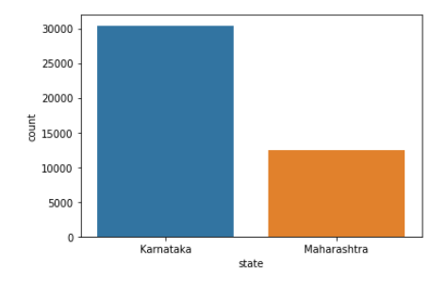
Distribution of data into different cities and states

Slide 6
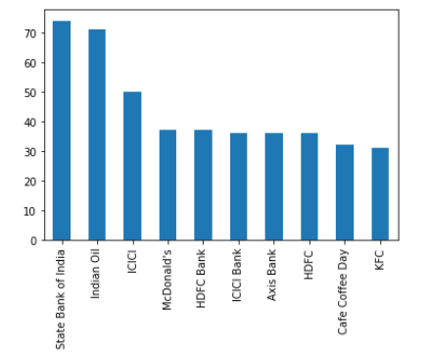
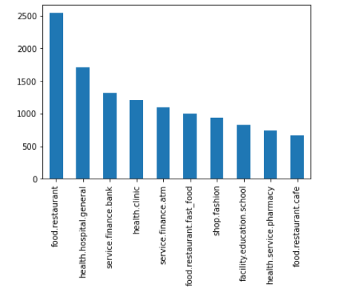
Distribution of top 10 brands and poi_type from dataset

Slide 7
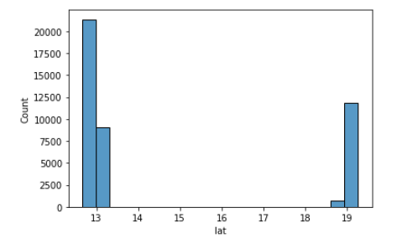
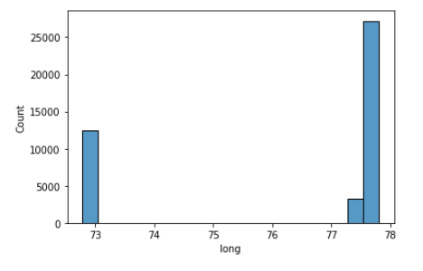
Distribution of latitude and longitude from the given dataset

Slide 8
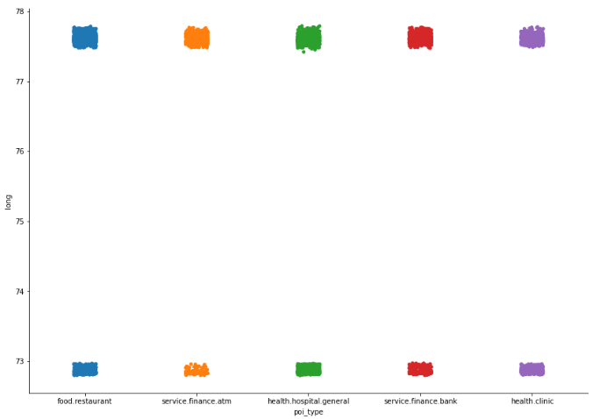
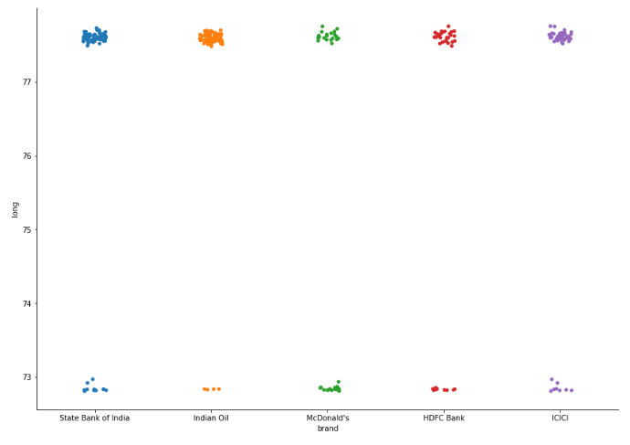
Top 5 poi_type and brands with respect to longitute

Slide 9
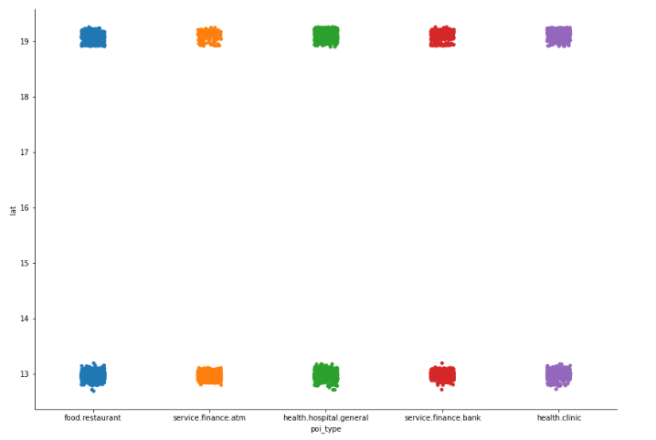
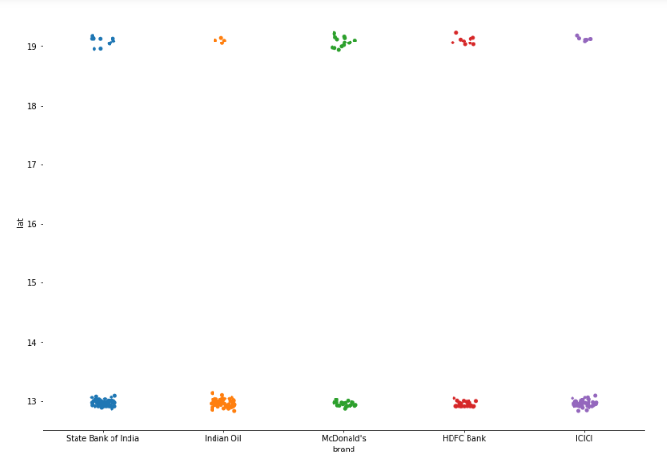
Top 5 poi_type and brands with respect to latitute

Slide 10
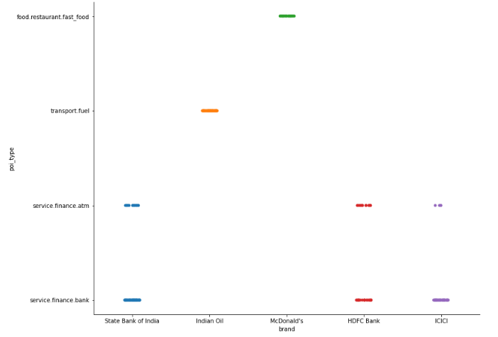
Which top 5 brands represents which poi_types?

Slide 11
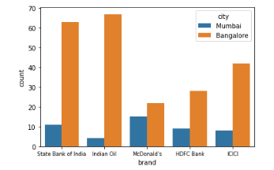
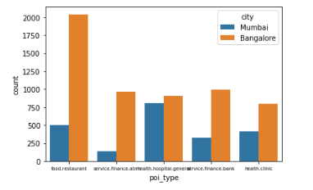
Distribution of top 5 brands and poi_type with respect to the cities

Slide 12
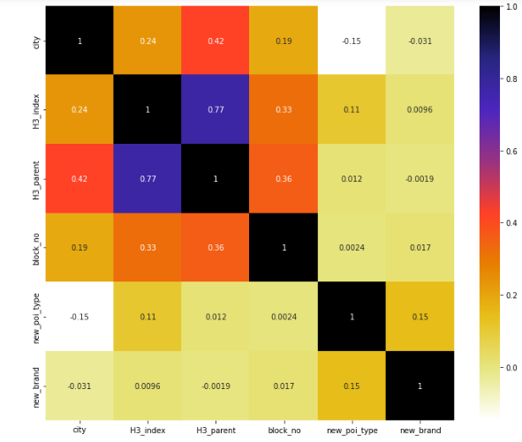
Correlation Matrix for all features used for clustering

Slide 13
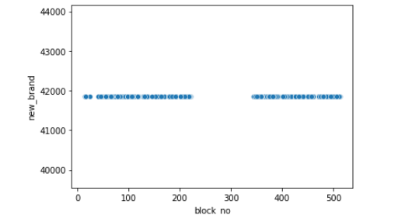
Cluster 0
From this plot we can conclude that block/locality of this cluster0 only contains one type of brand which is represented by 42000 in numerical format

Slide 14
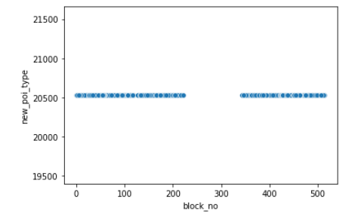
Cluster 1
From this plot we can conclude that block/locality of this cluster only contains one type of poi_type which is represented by 20500 in numerical format

Slide 15
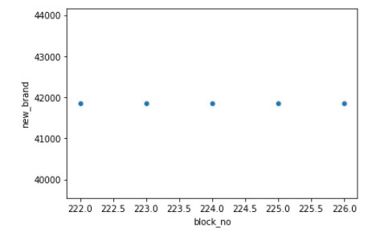
Cluster 2
From this plot we can conclude that block/locality of this cluster are ranging from 222 to 226 so it is a small region and it only contains one type of brand which is represented by 42000 in numerical format

Slide 16
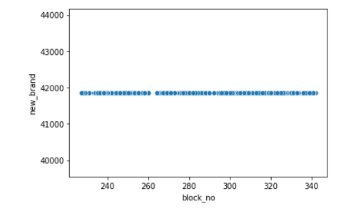
Cluster 3
From this plot we can conclude that block/locality of this cluster only contains one type of brand which is represented by 42000 in numerical format

Slide 17
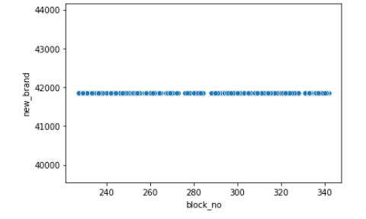
Cluster 4
From this plot we can conclude that block/locality of this cluster only contains one type of brand which is represented by 42000 in numerical format

Slide 18
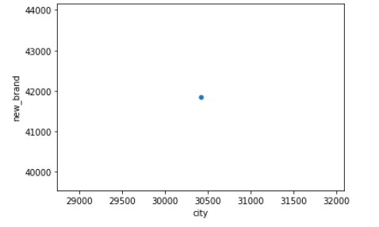
Cluster 5
From this plot we can conclude that block/locality of this cluster only contains one type of brand which is represented by 42000 in numerical format and this cluster belong to only 1 city represented by 30500

Slide 19
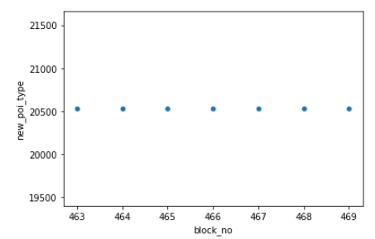
Cluster 6
From this plot we can conclude that block/locality of this cluster which is of small size ranging from 463 to 469 only contains one type of poi_type which is represented by 20500 in numerical format

Slide 20
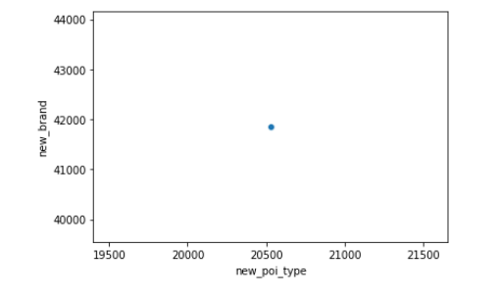
Cluster 7
From this plot we can conclude that this cluster has only 1 poi_type which is represented by 20500 and 1 type of brand represented by 42000

Slide 21
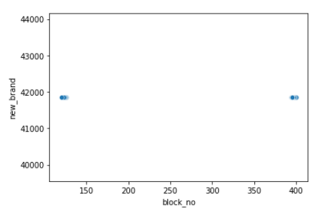
Cluster 8
From this plot we can conclude that block/locality of this cluster does not contains any brand from range 150 to almost 400.

Slide 22
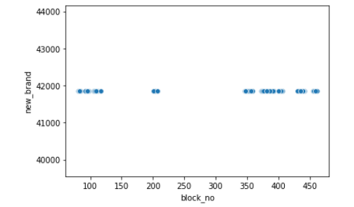
Cluster 9
From this plot we can conclude that block/locality of this cluster does not contains any brand from range 150 to around 200 and 210 to 350. And locality that do contain brand has only 1 type of brand represented by 42000

Slide 23
Summary
So after doing some basic exploratory data analysis and Feature Engineering along with Feature Selection then finally clustering we were able to segment places and provide insights
This project can help various people if they intent to
Start a new business and want to get some idea
An established business trying to find out their competition
Probability of success of business
Missing business in the locality

Slide 24
Thank You!

